Slide 1

Movie Recommendation System using Kmeans Clustering
Movie Recommendation System

Slide 2

Abstract
The main focus of this presentation:
Develop a Kmeans clustering method to recommend movies to a user by watching a movie.

Slide 3

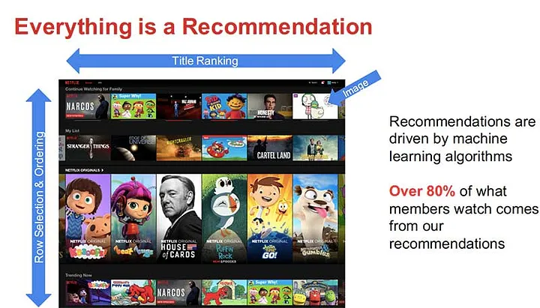
Abstract
Recommender systems predict consumers’ preferences for products and provide proactive suggestions for items they would enjoy.

Slide 4
Abstract
most common types of recommendation models:
Collaborative filtering
content-based
Hybrid recommendation

Slide 5
Abstract
Collaborative filtering generates suggestions based on previous interactions between the user and the item
Majority of content-based recommendations are based on item comparisons.
The majority of hybrid recommender systems are made up of a mix of collaborative filtering and content-based recommender models

Slide 6
Abstract
The Content-Based method was used as the main model in this study, k-means clustering can be applied in certain recommendation scenarios by selecting appropriate features.

Slide 7
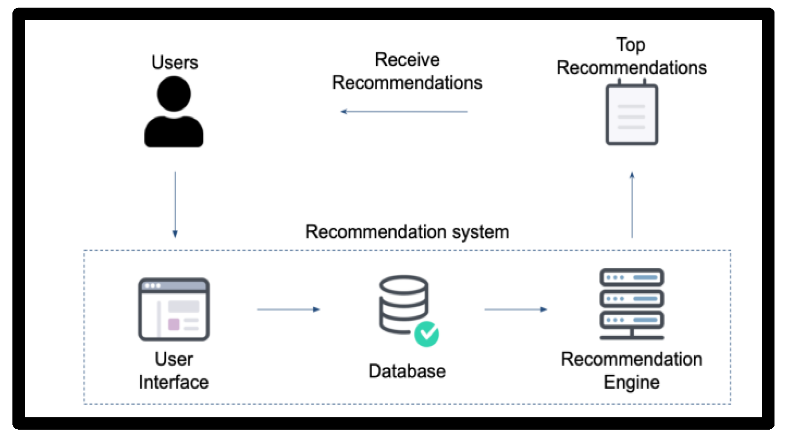
Introduction
A recommendation system is a program that employs various filtering algorithms to deliver suggestions and forecasts to users.

Slide 8
Introduction
The movie business has grown in recent years, with hundreds of films made practically every year; as a result, consumer over-choice has become a problem. As a result, both business and research have embraced movie recommendation systems. Many approaches have been taken in developing recommendation systems.

Slide 9
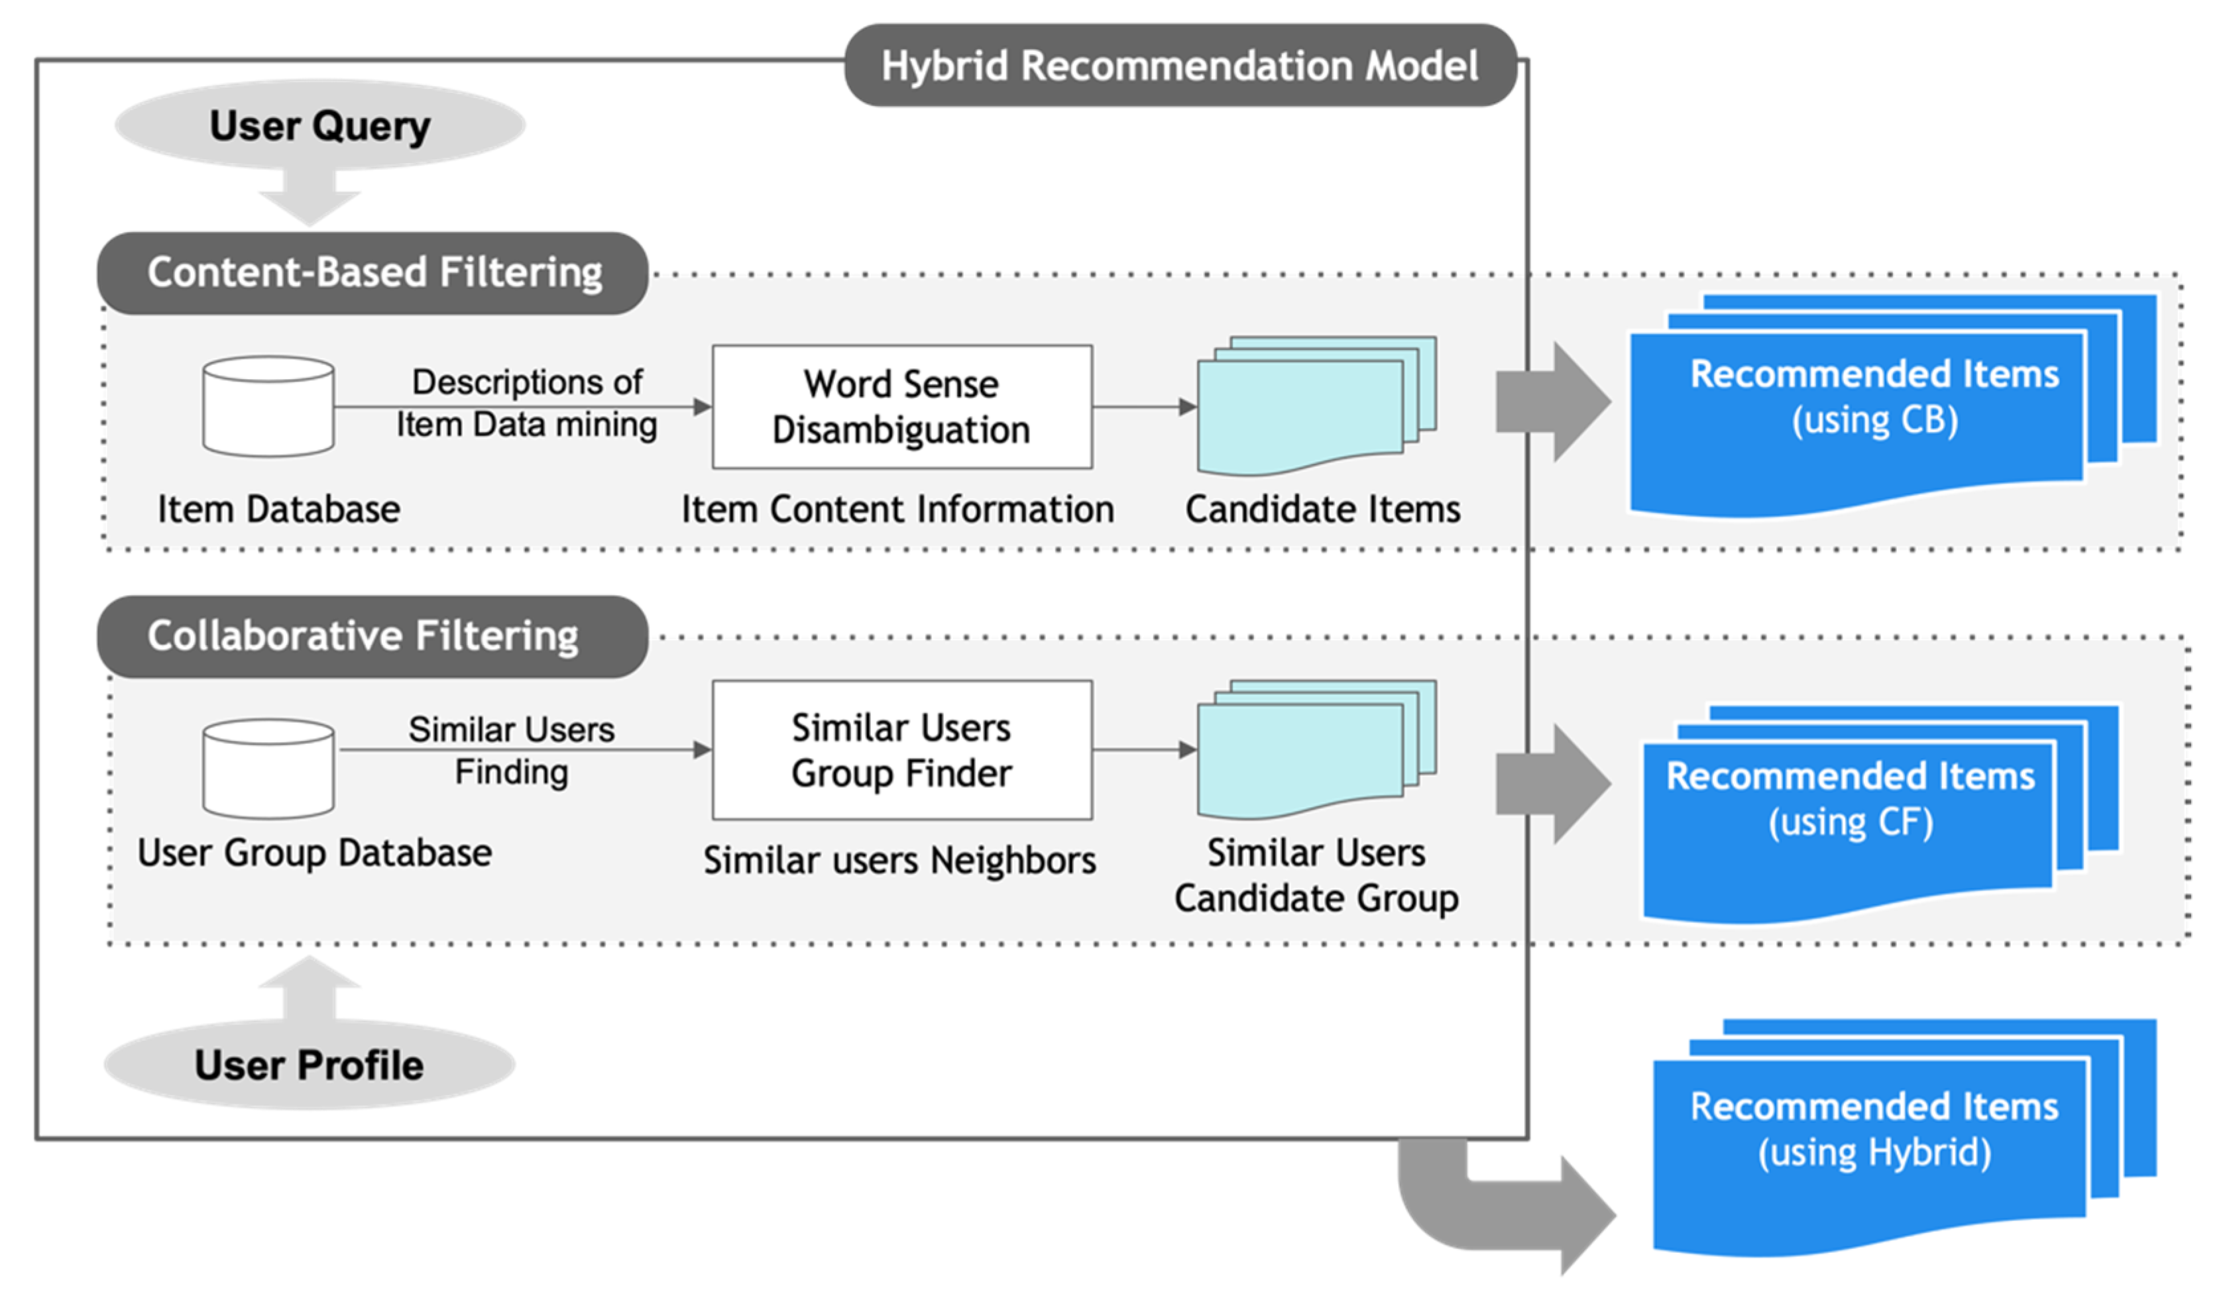
Introduction
What’s our approach?
we offer a collaborative filtering recommendation system based on content. We utilize a keywords feature extraction technique for the content-based approach.

Slide 10
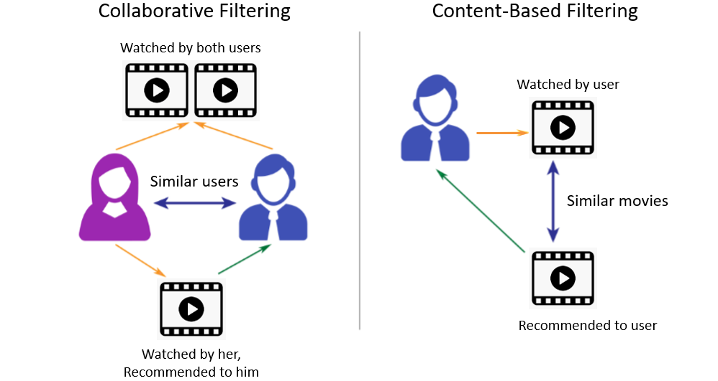
Introduction
General overview of
content-based recommendation systems

Slide 11
Introduction
What’s our approach?
using the Rapid Automatic Keyword Extraction (RAKE) and TF-IDF algorithms to extract keywords, which we then use to calculate the cosine similarity matrix and propose movies with similar plots.
We propose a model that predicts user ratings using a weighted average method with cosine similarity as the weights for the collaborative filtering technique.
To assess the accuracy of the model predictions, we use the Root Mean Square Error as the error measure

Slide 12
Content-Based
A content based recommender works with data that the user provides, either explicitly (rating) or implicitly (clicking on a link). Based on that data, a user profile is generated, which is then used to make suggestions to the user. As the user provides more inputs or takes actions on the recommendations, the engine becomes more and more accurate.

Slide 13
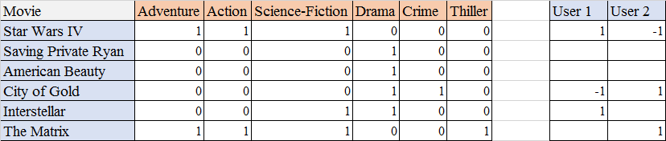
Content-Based (cntd)
This method uses some information that can extract item characteristics as training data.
Some content-based movie recommendation systems employ movie metadata (e.g. movie genre, cast, director of the movie) as input.

Slide 14
Content-Based (cntd)
Text documents are the other most common information source for content-based recommendation systems and we can get help from NLP to process content.

Slide 15
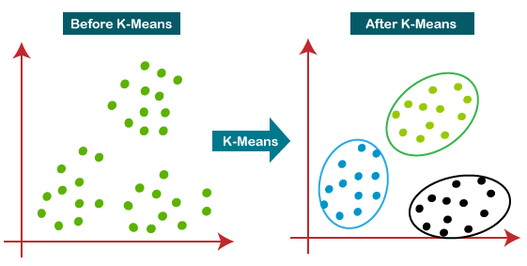
K-means
K-means clustering is a popular machine learning algorithm used for grouping similar data points into clusters. While it is not typically used directly for movie recommendation systems, it can be applied as a part of the recommendation process.

Slide 16
K-means (cntd)
In movie recommendation systems, clustering techniques like k-means can be employed to identify groups of users or movies with similar characteristics. This is often done by analyzing features such as movie genres, actors, directors, user ratings, or other relevant attributes.

Slide 17
TF-IDF (cntd)
TF-IDF for a word in a document is calculated by multiplying two different metrics:
The term frequency of a word in a document. There are several ways of calculating this frequency, with the simplest being a raw count of instances a word appears in a document. Then, there are ways to adjust the frequency, by length of a document, or by the raw frequency of the most frequent word in a document.

Slide 18
TF-IDF (cntd)
TF-IDF for a word in a document is calculated by multiplying two different metrics: (cntd)
The inverse document frequency of the word across a set of documents. This means, how common or rare a word is in the entire document set. The closer it is to 0, the more common a word is. This metric can be calculated by taking the total number of documents, dividing it by the number of documents that contain a word, and calculating the logarithm.
So, if the word is very common and appears in many documents, this number will approach 0. Otherwise, it will approach 1.

Slide 19
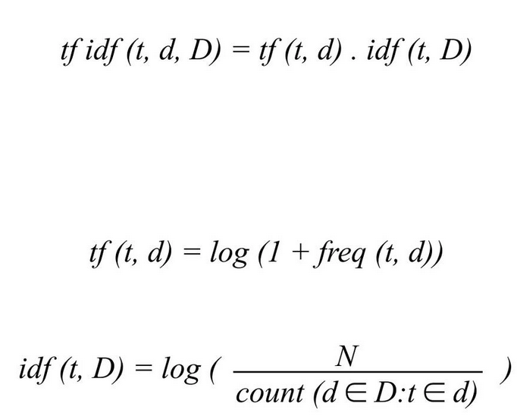
TF-IDF (cntd)
the TF-IDF score for the word t in the document d from the document set D is calculated as follows:

Slide 20
TF-IDF (cntd)
the TF-IDF score for the word t in the document d from the document set D is calculated as follows:

Slide 21
RAKE
Rapid Automatic Keyword Extraction, like TF-IDF, has been a valuable technique in the creation of recommendation systems.
(RAKE) is an unsupervised algorithm for extracting keywords from research.
Rake is a keyword extraction algorithm that is extremely efficient and operates on individual documents to enable an application to the dynamic collection; it can also be applied on new domains very easily and also very effective in handling multiple types of documents, especially the type of text which follows specific grammar conventions.

Slide 22
RAKE (cntd)
Rake is based on the observations that keyword frequently contain multiple words with standard punctuation or stop words, or we can say functioning words like ‘and’, ‘of’, ‘the’, etc with minimum lexical meaning. Stop words are typically dropped within all the informational systems and also not included in various text analyses as they are considered to be meaningless. Words that are considered to carry a meaning related to the text are described as content bearing and are called content words.

Slide 23
Collaborative Filtering
Collaborative filtering is a technique that can filter out items that a user might like on the basis of reactions by similar users.
It works by searching a large group of people and finding a smaller set of users with tastes similar to a particular user. It looks at the items they like and combines them to create a ranked list of suggestions.
There are many ways to decide which users are similar and combine their choices to create a list of recommendations.

Slide 24
Collaborative Filtering (cntd)
To experiment with recommendation algorithms, you’ll need data that contains a set of items and a set of users who have reacted to some of the items.
The reaction can be explicit (rating on a scale of 1 to 5, likes or dislikes) or implicit (viewing an item, adding it to a wish list, the time spent on an article).

Slide 25
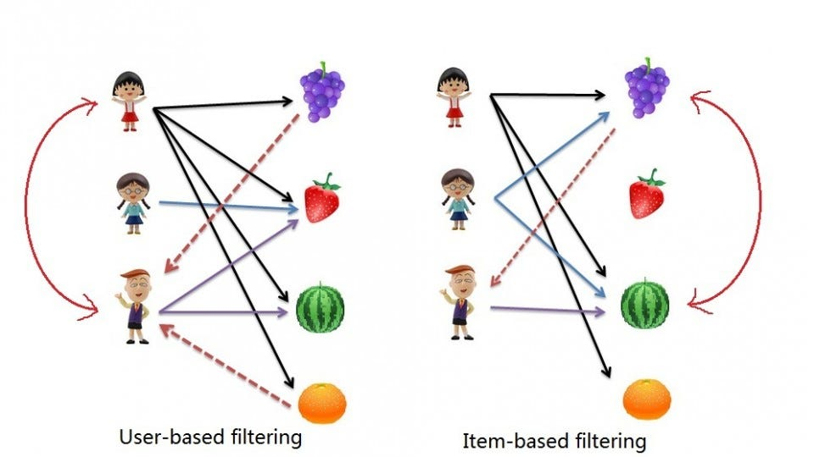
Collaborative Filtering (cntd)
Two different approaches of collaborative filtering:

Slide 26
Methodology

Slide 27

Data
We use two sets of MovieLens datasets:
one retrieved from the MovieLens website, which has 27,753,444 ratings and 1,108,997 tag applications scattered across 58098 movies and was gathered between January 9,1995 and September 26, 2018, and was made by 283,228 people.
The second dataset is likewise part of the MovieLens dataset; it is known as the MovieLens 100K and was obtained from the Kaggle website. The dataset contains 100,000 ratings (1-5) from 943 users on 1682 movies, with each user rating at least 20 movie

Slide 28
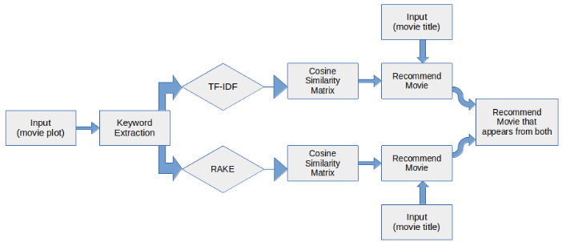
Models and Feature Extraction
We define two types of recommendation system models:
content-based (CB)
For the CB, we utilize two sets of keyword extractors for feature extraction: TF-IDF and RAKE on a set of 45,466 movie plots. Each keyword extractor can be utilized independently of the others.

Slide 29
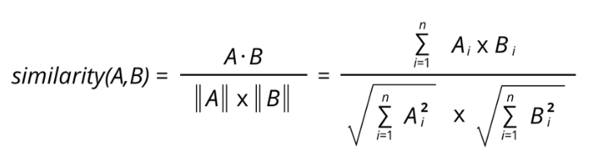
Models and Feature Extraction (cntd)
2. collaborative filtering
The CF portion of the recommender system uses 1682 entries of user ratings from the 100K Movielens dataset and uses the weighted average and cosine similarity value methods of user movie ratings to calculate and predict user ratings.

Slide 30
Evaluation
To evaluate our CB recommendation system, we compare the results from the two keyword extractors and divide the total number of identical movies recommended by the two models by the total number of movies recommended.

Slide 31
Evaluation (cntd)
How we evaluate?
The MSE (Mean squared error) in this study is used to evaluate the accuracy of the evaluation predicted by the model.
SVD and KNN, are used to improve RMS (Root mean square) error assessment.
We can also employ NMF,SVD++, KNN with Z Score, and CoClustering, models to compare the performance of our SVD and KNN

Slide 32
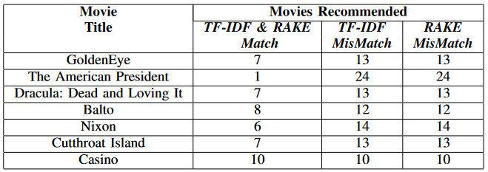
Results (CB)
In this section, we will go through the outcomes of our
recommendation system.
For an example, seven movie titles were chosen to recommend 20 films with comparable plots. Using cosine similarity matrices generated by keyword extractors TF-IDF and RAKE on movie plots, we used each movie title to recommend movies with similar movie plots.
19
19

Slide 33
Results (CB)
In example, with matching suggestions for Casino being our highest combined matched recommendations, we propose 10 movies to viewers who want to see a film with a narrative similar to Casino.
And The American President has the lowest combined recommendation, with only one film recommended. Because TF-IDF and RAKE utilize distinct ways to extract key phrases, the significant percentage of movies that deviate from both suggestions is expected.

Slide 34
Results (CB)
From the set, a total of 244 movies were recommended, with an average of 34 movies recommended per movie (it means total of two CB recommender).
Once movies put into recommendation algorithm (match of two algorithms) We receive an average of 7 movies recommended per title supplied from the entire movies that were recommended, demonstrating that we can combine RAKE and TF-IDF to recommend movies using movie plot and extracting the similar movies acquired by utilizing the keywords extraction models.

Slide 35
Results (CB)
The combined findings demonstrate that there is a significant chance that utilizing separate keyword extractors and picking movies that are the same from each extraction recommendation system would likely propose movies that the viewer will appreciate.

Slide 36
Results (CF)
The test run on the recommendation system’s Collaborative Filtering component to forecast user rating yielded a mean squared error of 1.0172 on the test set. To decrease this score, we first used KNN and SVD models, as well as 10 fold cross validation with RMSE and MAE as metrics.
Both training and testing times were reduced in terms of performance.
When it came to training time, the KNN model outperformed the SVD, and when it came to testing time, the SVD outperformed the KNN model.

Slide 37
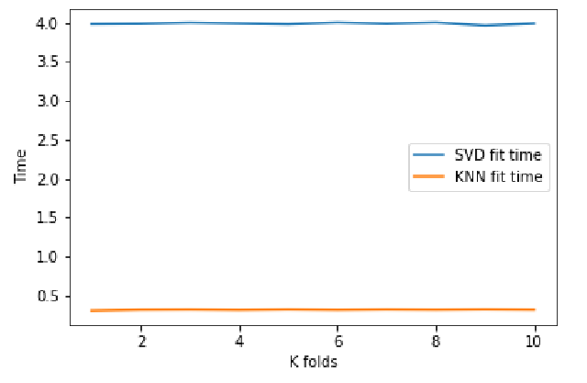
Results (CF)
SVD VS KNN with respect to training time

Slide 38
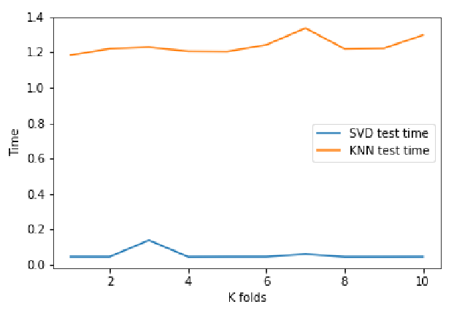
Results (CF)
SVD VS KNN with respect to testing time

Slide 39
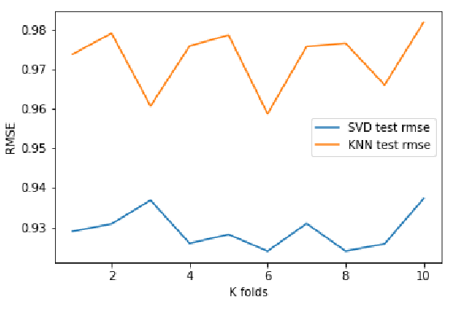
Results (CF)
The RMS error for the KNN model was 0.97, whereas the MAE averaged 0.77. The RMS error for the SVD model is typically 0.92, with an average MAE of 0.76

Slide 40
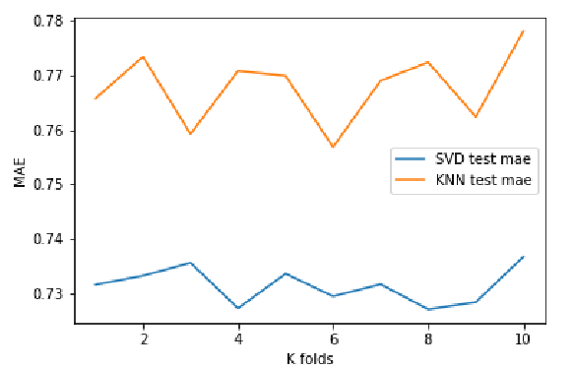
Results (CF)
MAE

Slide 41
Results (CF)
To assess the validity of our KNN and SVD models, we performed an RMSE-MSE comparison test with four additional models: NMF,SVD++, KNN with Z Score, and CoClustering.
As a baseline, we predicted the identical user’s ratings using all of the models, and the SVD++ model performed better than all of the other models, with the lowest RMS error score of 0.90 and MA error value of 0.70. With 0.91 for the RMSE and 0.72 for the MAE, our SVD model has the second best per error scores.
When compared to the other models, our KNN model performed the poorest, with error values of 0.95 for RMSE and 0.75 for MAE.

Slide 42
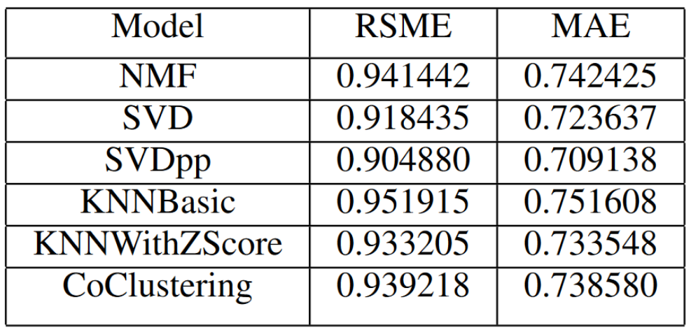
Results (CF)

Slide 43
Results (CF)
In general, SVD delivers more accurate predictions than
KNN, but the findings also reveal that CoClustering model outperforms our basic KNN model, but KNN with Z Score outperforms both basic KNN and CoClustering model.
These findings demonstrate that the best model to use for predicting user ratings is the SVD++, and KNN with Z Score would outperform a standard KNN model when it comes to predicting user ratings.

Slide 44
CONCLUSION
The results of combining TF-IDF and RAKE to suggest movies based on the movie plot demonstrate that we can combine RAKE and TF-IDF to recommend movies based on the movie plot and extract comparable movies obtained by using keywords extraction models. There is a significant chance that utilizing separate keyword extractors and picking movies that are the same from each extraction recommendation system would likely propose movies that the viewer will appreciate.

Slide 45
CONCLUSION
SVD++ is the best model to use for predicting user ratings, and KNN with Z Score would outperform a standard KNN model when it comes to predicting users’ ratings. We can see another path to movie recommendation systems with the combination of a CF predicting user ratings with minimal error, which will help with the development of movie recommendation systems.

Slide 46
Thanks for attention ☺

